Slide 1

Module 3 –In Memory Computation
Spark DataFrames

Slide 2

IN MEMORY COMPUTATION-SPARK
Spark Trend
Less RDD and more dataframes
Better interoperability
ML Lib and streaming are moving towards using dataframes
Simplify development
Most SQL like operations in one line

Slide 3
IN MEMORY COMPUTATION-SPARK
Dataset Vs Dataframe
Dataframe is really a dataset of row objects
Datasets can wrap known typed data too. Python in untyped
Try to use scala whenever possible
Typed, store more efficiently
Optimized at compile time

Slide 4
IN MEMORY COMPUTATION-SPARK
Shell Access
SparkSQL exposes a JDBC/ODBC server( built spark with HIVE support)
Start it with sbin/start-thriftserver.sh
Listens on port 10000by default
Connect using bin/beeline –u jdbc:hive2://localhost:10000
SQL shell to spark SQL

Slide 5
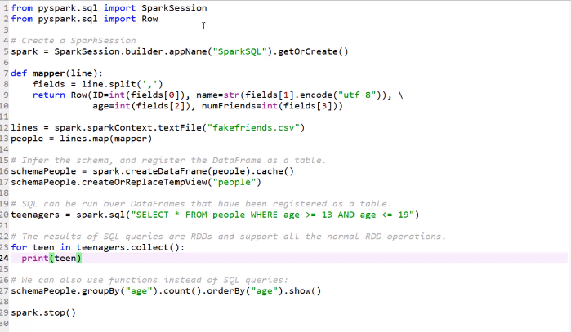
IN MEMORY COMPUTATION-SPARK
RDD dataframe Creation

Slide 6
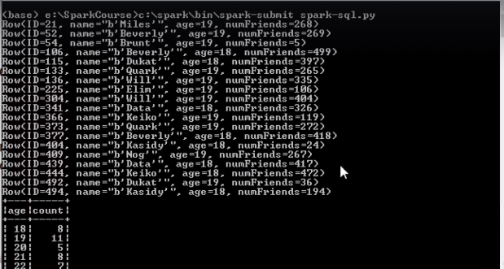
IN MEMORY COMPUTATION-SPARK
RDD dataframe Creation

Slide 7
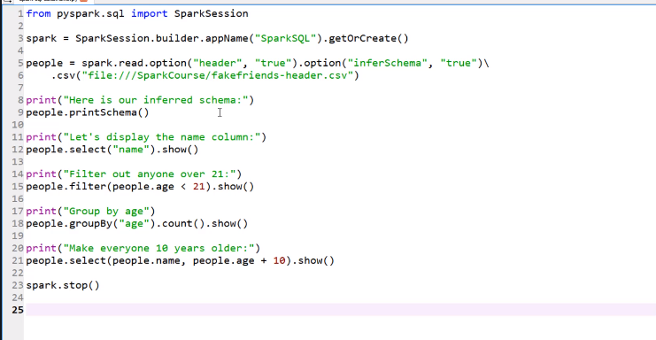
IN MEMORY COMPUTATION-SPARK
Dataframe creation

Slide 8
BIG DATA
Exercise
Consider a case where you have data in a CSV file that consists of <pan number, date, tax_paid> and you wanted to find out the total tax paid by each individual pan holder
How will you do it in Spark?
How will you do it with Spark Data frames

Slide 9
BIG DATA
Task Assignment
Consider a case where you have data in a CSV file that consists of <pan number, date, tax_paid> and you wanted to find out the total tax paid by each individual pan holder
How will you do it in Spark?
How will you do it with Spark Data frames
Using Dataframes
Df = rdd.toDF(“pan number”, “date”, “taxpaid”)
Df.select(“pan number”, “tax paid”).groupBy(“pan number”).sum()
Note that this is done using the name of the column rather than by splitting the data which we would do if used Spark.
Notes:
Using Spark – read the csv, create an RDD for input.
Split on , and read the pan and tax. Pair RDD – pan as key and tax as value.
Groupbykey and sum.

Slide 10
BIG DATA
DryadLINQ, FlumeJava
Similar “distributed collection” API, but cannot reuse datasets efficiently across queries
Relational databases
Lineage/provenance, logical logging, materialized views
GraphLab, Piccolo, BigTable, RAMCloud
Fine-grained writes similar to distributed shared memory
Iterative MapReduce (e.g. Twister, HaLoop)
Implicit data sharing for a fixed computation pattern
Caching systems (e.g. Nectar)
Store data in files, no explicit control over what is cached
Task Assignment

Slide 11
THANK YOU

